Slide 1
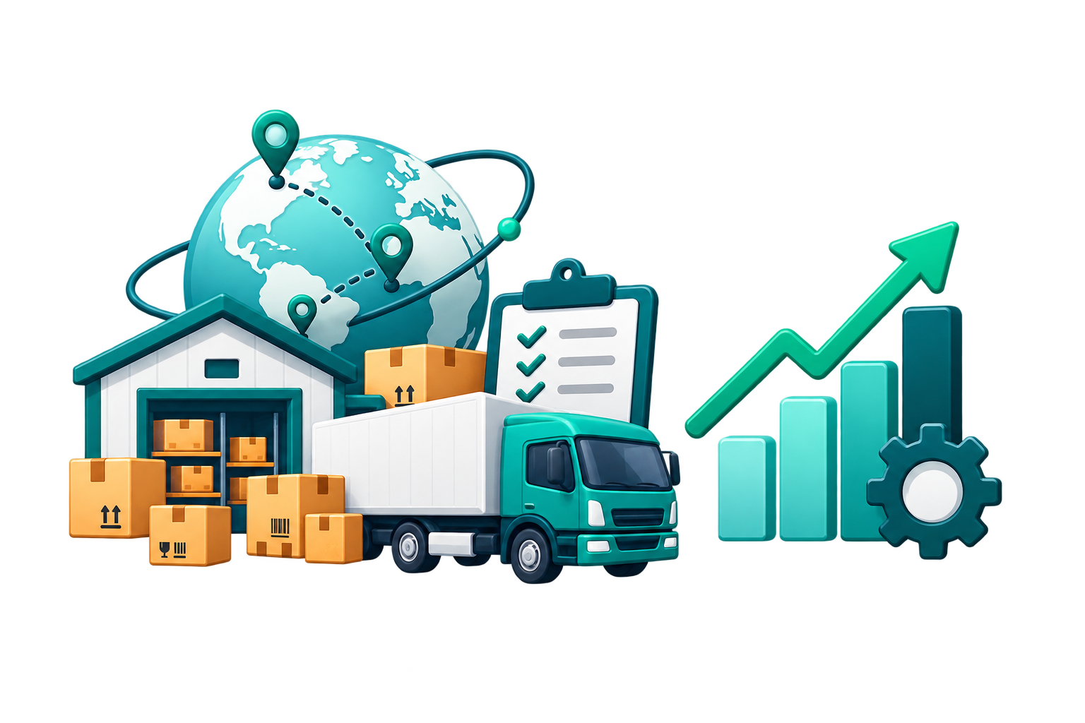
SUPPLY CHAIN
ANALYTICS
Client Problem Statement & Glossary
Power BI dashboard brief for logistics-sector procurement, supplier performance, and delivery analytics.
POWER BI PROJECT
PL-300 PRACTICE
CLIENT READY
Awesome Analytics

Slide 2
CLIENT CONTEXT
Supply Chain Analytics Dashboard
Why this dashboard is needed
A logistics-sector client needs one view of procurement spend, supplier risk, and delivery performance.
Procurement and logistics teams are working with multiple operational tables: purchase orders, supplier master data, quantity logs, shipment records, carrier data, warehouse data, and monthly targets.
Management cannot quickly compare actual spend against monthly targets.
Supplier performance is split across pricing, quality, delivery, and risk fields.
Logistics teams need carrier, transport mode, freight cost, and delay visibility.
Goal: replace scattered checks with a clean 3-page Power BI report that supports executive review, supplier decisions, and logistics improvement.
Client Problem Statement & Glossary

Slide 3
CLIENT PROBLEM STATEMENT
Supply Chain Analytics Dashboard
Core business problems to solve
The dashboard should answer real operating questions, not just display charts.
01
Spend visibility
02
Supplier pricing control
Track actual procurement spend and compare it with target spend by month and product category.
Identify suppliers or categories where actual unit prices move unfavorably against contracted rates.
03
Delivery reliability
04
Quality leakage
Measure on-time delivery and isolate delayed shipments by supplier, carrier, region, and transport mode.
Monitor rejected quantities and supplier quality scores to spot risk before it becomes cost.
05
Logistics cost pressure
06
Executive clarity
Analyze freight cost distribution across carriers and transport modes.
Create a clean overview for decision-makers with KPIs, trends, and variance drivers.
Client Problem Statement & Glossary

Slide 4
DASHBOARD OBJECTIVES
Supply Chain Analytics Dashboard
What the report must answer
Three pages should tell a complete business story: overview → supplier/procurement → logistics.
Page 1: Overview
Page 2: Supplier & Procurement
Page 3: Logistics & Delivery
Executive view of spend, orders, delivery health, quality, risk, and delay root cause.
Procurement deep-dive focused on supplier performance, pricing control, and quality.
Logistics deep-dive focused on freight cost, carrier SLA, transit speed, and delay patterns.
Actual vs target spend
Spend variance by category
PO status + supplier risk
Delivery delay analysis
Supplier performance scatter
PPV by supplier
Supplier detail matrix
Monthly PPV trend
Carrier OTD vs SLA
Freight by transport mode
Transit time by carrier
Monthly OTD trend
Design principle: keep the model analytical, but keep the report explainable for beginner-to-intermediate viewers.
Client Problem Statement & Glossary

Slide 5
KPI SCOPE
Supply Chain Analytics Dashboard
Final KPI dictionary
These are the business metrics used across the three dashboard pages.
KPI
Core logic
Why it matters
Actual Spend
Actual Unit Price × Ordered Qty
Procurement cost
Total POs
Distinct PO_ID
Order volume
OTD %
On-time delivered ÷ delivered shipments
Delivery reliability
Avg Lead Time
Order date → actual delivery date
End-to-end procurement speed
Rejection Rate %
Rejected Qty ÷ Received Qty
Quality leakage
PPV %
(Actual Spend − Contract Spend) ÷ Contract Spend
Pricing variance
Freight Cost
Sum Freight_Cost_INR
Logistics cost
SLA Gap
Actual OTD % − Carrier SLA Target
Carrier performance vs commitment
Client Problem Statement & Glossary

Slide 6
GLOSSARY 1/3
Supply Chain Analytics Dashboard
Procurement glossary
Use these definitions while explaining the business problem in the tutorial.
Purchase Order (PO)
Formal order placed with a supplier to buy goods or services.
PO Line
Individual product or item line inside a purchase order. One PO can contain multiple PO lines.
Actual Spend
Money spent based on actual unit price and ordered quantity.
Target Spend
Planned or budgeted procurement spend for a month and product category.
Spend Variance
Target Spend − Actual Spend. Positive means under target; negative means overspend.
PPV %
Purchase Price Variance: actual purchase cost compared with contracted cost.
Rejection Rate %
Rejected quantity divided by received quantity; a quality-performance metric.
Recording note: avoid saying “profit” here. This dashboard tracks procurement cost control, not sales revenue or margin.
Client Problem Statement & Glossary

Slide 7
GLOSSARY 2/3
Supply Chain Analytics Dashboard
Supplier glossary
These terms explain how the supplier performance page is read.
Supplier Rating
Overall supplier assessment score, typically based on multiple supplier-performance dimensions.
Quality Score
Supplier quality score, useful for monitoring defects, rejections, or quality risk.
Delivery Score
Supplier delivery-performance score, useful for reliability comparison.
Risk Level
Supplier risk segmentation such as Low, Medium, or High, based on operational and financial indicators.
Contract Unit Price
Agreed price per unit according to contract or supplier agreement.
Actual Unit Price
Price actually paid per unit in the procurement transaction.
Supplier Exposure
Spend amount tied to a supplier; high spend with weak performance creates higher business risk.
Client Problem Statement & Glossary

Slide 8
GLOSSARY 3/3
Supply Chain Analytics Dashboard
Logistics glossary
These definitions support the logistics and delivery performance page.
Carrier
Logistics partner responsible for moving goods from dispatch to delivery.
Transport Mode
Shipment mode such as Road, Rail, or Air.
Freight Cost
Transportation cost charged for moving goods.
Transit Time
Number of days from dispatch date to actual delivery date.
Promised Date
Expected delivery date committed for the shipment.
On-Time Delivery %
Delivered shipments completed on or before promised date divided by total delivered shipments.
SLA Target
Service-level target agreed with the carrier for on-time delivery performance.
Client Problem Statement & Glossary

Slide 9
DATA MODEL + REPORTING RULES
Supply Chain Analytics Dashboard
Modeling decisions to explain simply
Keep this section short in the video; the goal is clarity, not theory overload.
1
Galaxy schema
The model uses two facts: actual procurement at PO-line grain and targets at category-month grain.
2
Conformed dimensions
Date and Category filter both facts, so actual vs target comparisons work correctly.
3
Do not merge targets into PO rows
Monthly targets would repeat across transactions and inflate target totals.
4
Use inactive date relationship only when needed
Monthly OTD trend uses delivery date with USERELATIONSHIP for correct delivery-month analysis.
5
Keep visuals business-first
Choose chart types based on the question and actual data distribution, not decoration.
Final message for clients: the report turns raw procurement and logistics records into decision-ready insights for cost control, supplier management, and delivery improvement.
Client Problem Statement & Glossary

